Slide 1
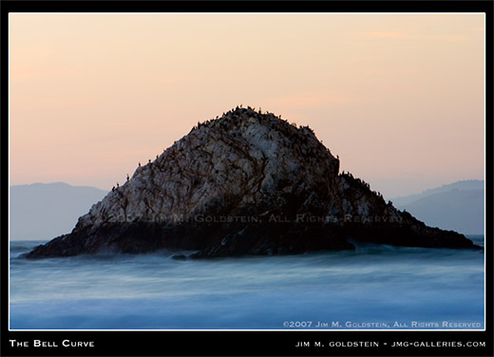
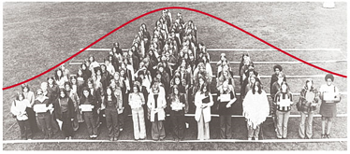
Chapter 6 (part 2) WHEN IS A Z-SCORE BIG? NORMAL MODELS
A Very Useful Model for Data

Slide 2
µ = 3 and σ = 1
μ
X
0
3
6
9
12
8
Normal Models: A family of bell-shaped curves that differ only in their means and standard deviations.
µ = the mean
σ = the standard deviation

Slide 3
Normal Models
The mean, denoted μ, can be any number
The standard deviation σ can be any nonnegative number
The total area under every normal model curve is 1
There are infinitely many normal models
Notation: X~N(μ, σ) denotes that data represented by X is modeled with a normal model with mean μ and standard deviation σ

Slide 4
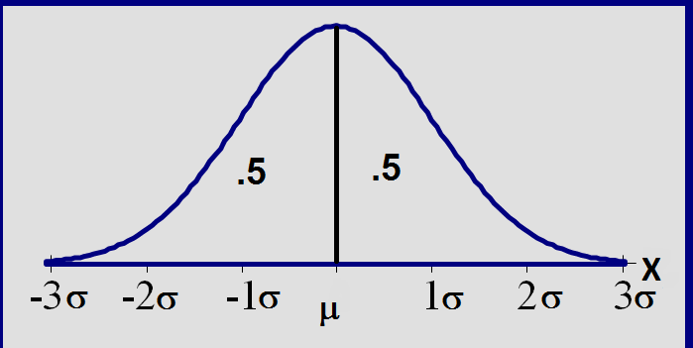
Total area =1; symmetric around µ

Slide 5
The effects of μ and σ
How does the standard deviation affect the shape of the bell curve?
σ= 2
σ =3
σ =4
How does the expected value affect the location of the bell curve?
μ = 10
μ = 11
μ = 12

Slide 6
µ = 3 and σ = 1
μ
X
0
3
6
9
12
µ = 6 and σ = 1
μ
X
0
3
6
9
12

Slide 7
μ
µ = 6 and σ = 2
X
0
3
6
9
12
8
µ = 6 and σ = 1
μ
X
0
3
6
9
12
8

Slide 8
µ = 6 and σ = 2
X
0
3
6
9
12
area under the density curve between 6 and 8 is a number between 0 and 1

Slide 9
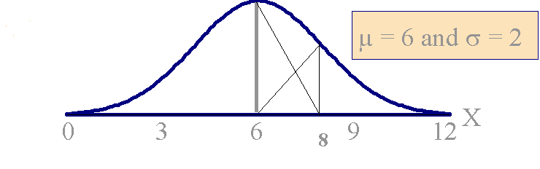
area under the density curve between 6 and 8 is a number between 0 and 1

Slide 10
Standardizing
Suppose X~N(μ, σ)
Form a new normal model by subtracting the mean μ from X and dividing by the standard deviation σ:
(X−μ)/ σ
This process is called standardizing the normal model.

Slide 11
Standardizing (cont.)
(X−μ)/ σ is also a normal model; we will denote it by Z:
Z = (X−μ)/ σ
Ζ has mean 0 and standard deviation 1:
μ = 0; σ = 1.
Ζ ∼ Ν(0, 1)
The normal model Z is called the standard normal model.

Slide 12
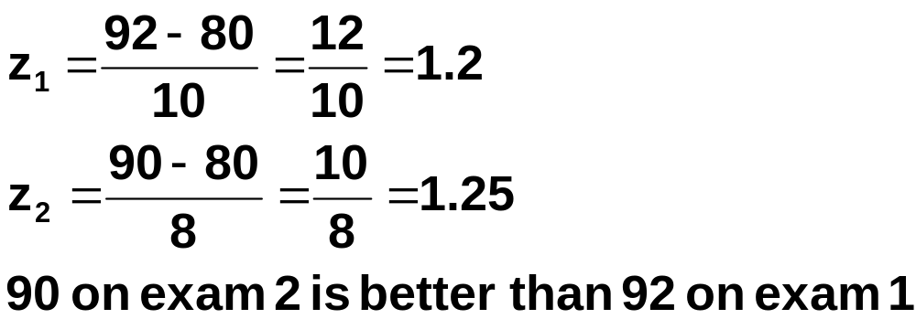
Standardizing (cont.)
If X has mean μ and stand. dev. σ, standardizing a particular value of x tells how many standard deviations x is above or below the mean μ.
Exam 1: μ=80, σ=10; exam 1 score: 92
Exam 2: μ=80, σ=8; exam 2 score: 90
Which score is better?

Slide 13
µ = 6 and σ = 2
X
0
3
6
9
12
8
(X-6)/2
µ = 0 and σ = 1
.5
.5
Z
-3
-2
-1
0
1
2
3

Slide 14
Standard Normal Model
.5
.5
.5
.5
Z
-3
-2
-1
0
1
2
3
Z~N(0, 1) denotes the standard normal model
μ = 0 and σ = 1

Slide 15
Important Properties of Z
#1. The standard normal curve is symmetric around the mean 0
#2. The total area under the curve is 1;
so (from #1) the area to the left of 0 is 1/2, and the area to the right of 0 is 1/2

Slide 16
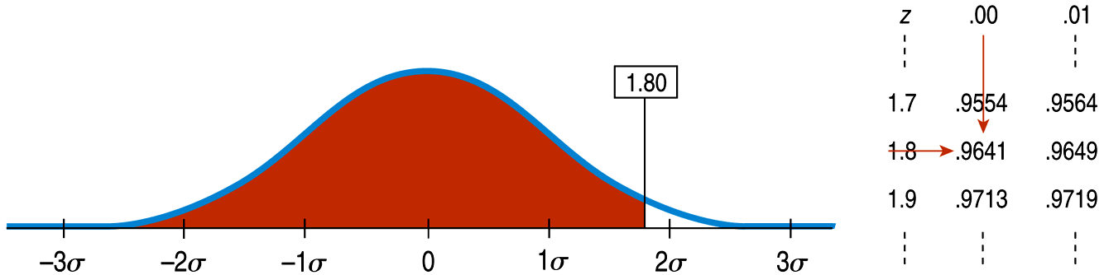
Finding Normal Percentiles by Hand (cont.)
Table Z is the standard Normal table. We have to convert our data to z-scores before using the table.
The figure shows us how to find the area to the left when we have a z-score of 1.80:

Slide 17
Areas Under the Z Curve: Using the Table
Proportion of area above the interval from 0 to 1 = .8413 - .5 = .3413
.50
.3413
.1587
Z
0
1

Slide 18
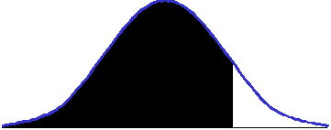
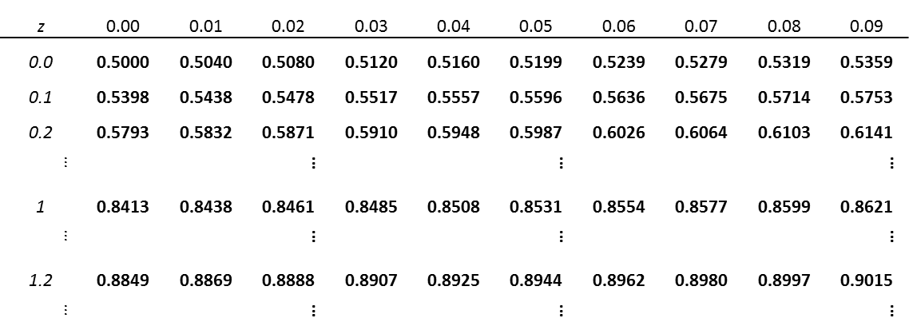
Standard normal areas have been
calculated and are provided in table Z.
Area between -∞ and z₀
The tabulated area correspond
to the area between Z= -∞ and some z₀
Z = z₀

Slide 19
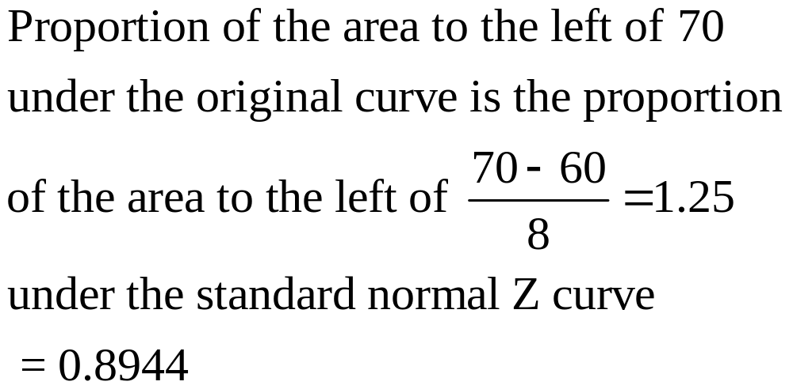
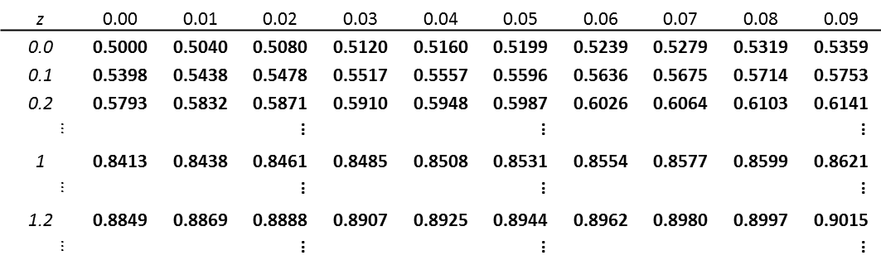
Example – begin with a normal model with mean 60 and stand dev 8
0.8944
0.8944
0.8944
0.8944
In this example z₀ = 1.25

Slide 20
Example
Area=.3980
Area between 0 and 1.27) =
0
1.27
z
.8980-.5=.3980

Slide 21
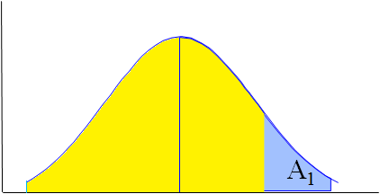
Example
A₂
0
.55
Area to the right of .55 = A₁
= 1 - A₂
= 1 - .7088
= .2912

Slide 22
Example
Area=.4875
Area between -2.24 and 0 =
Area=.0125
0
z
-2.24
.5 - .0125 = .4875

Slide 23
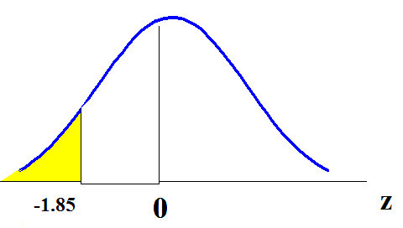
Example
Area to the left of -1.85 = .0322

Slide 24
Example
.9968
A₁
A₂
A
A₁
z
-1.18
0
2.73
.1190
Area between -1.18 and 2.73 = A - A₁
= .9968 - .1190
= .8778

Slide 25
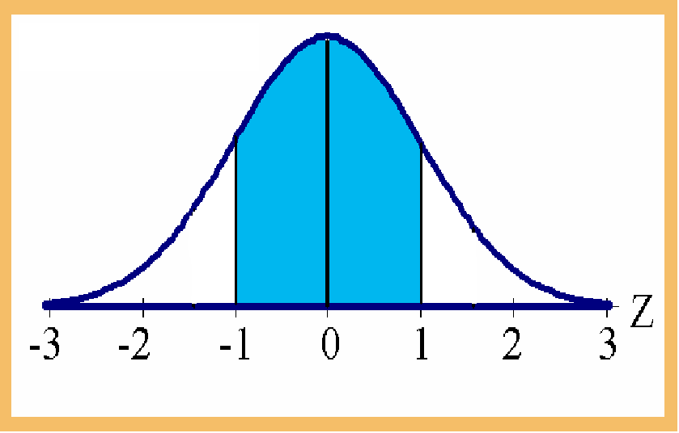
Area between -1 and +1 = .8413 - .1587 =.6826
Example
.6826
.1587
.8413

Slide 26
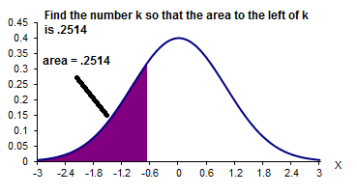

Example
-.67
Is k positive or negative?
Direction of inequality; magnitude of probability
Look up .2514 in body of table; corresponding entry is -.67

Slide 27
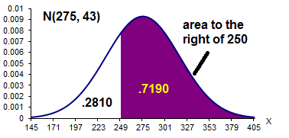
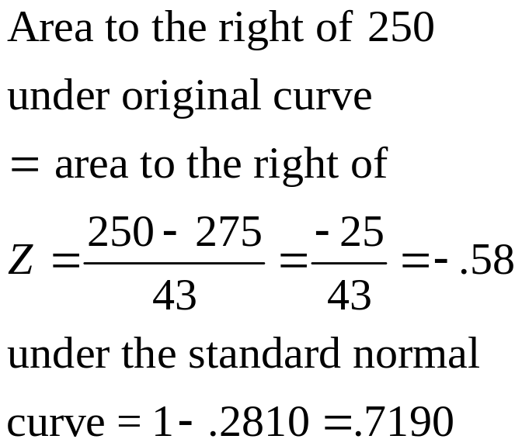
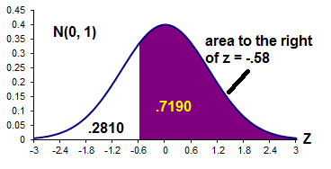
Example

Slide 28
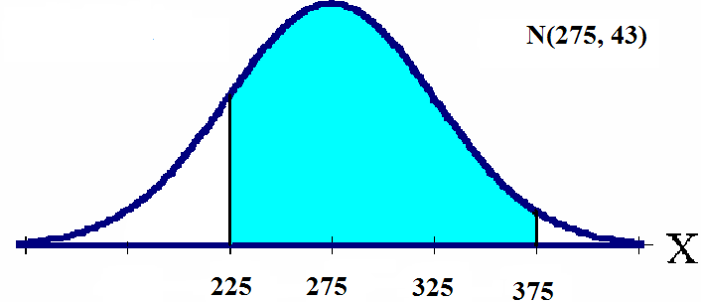
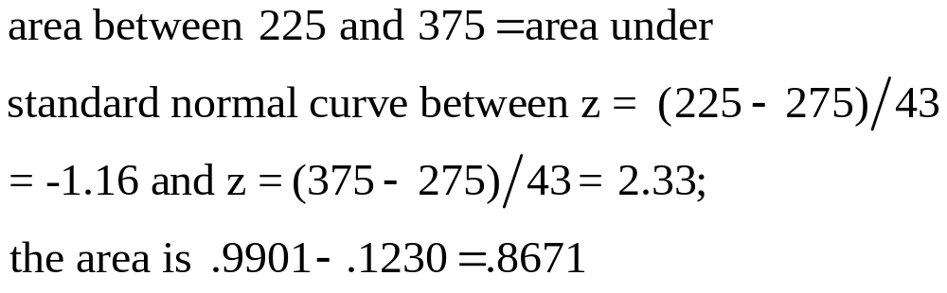
Example
.8671
.1230
.9901

Slide 29
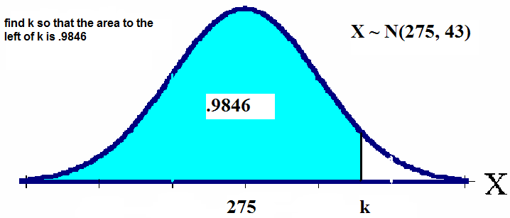
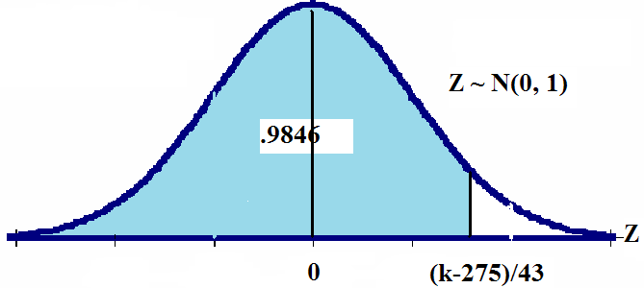
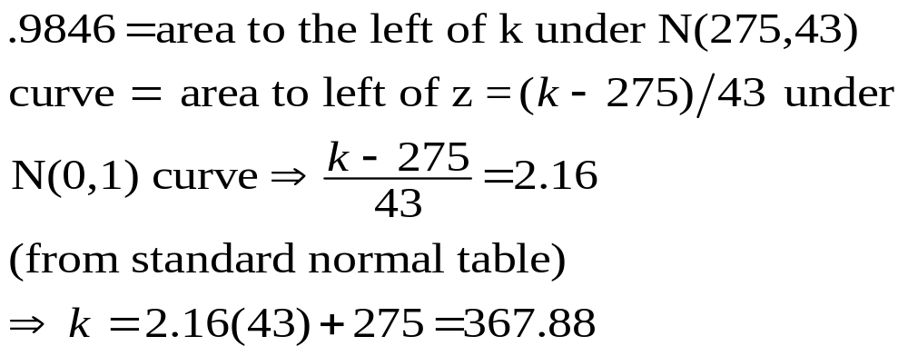
N(275, 43); find k so that area to the left is .9846

Slide 30
Area to the left of z = 2.16 = .9846
.9846
Area=.5
.4846
.1587
0
2.16
Z

Slide 31
Example
Regulate blue dye for mixing paint; machine can be set to discharge an average of μ ml./can of paint.
Amount discharged: N(μ, .4 ml). If more than 6 ml. discharged into paint can, shade of blue is unacceptable.
Determine the setting μ so that only 1% of the cans of paint will be unacceptable

Slide 32
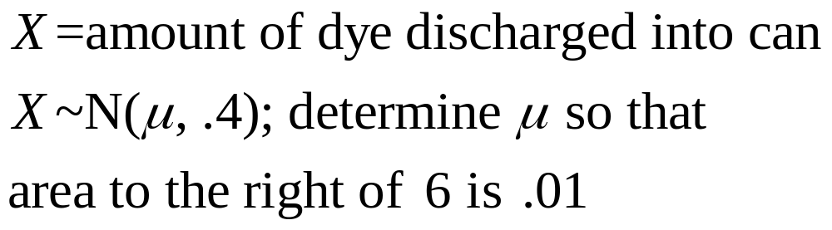
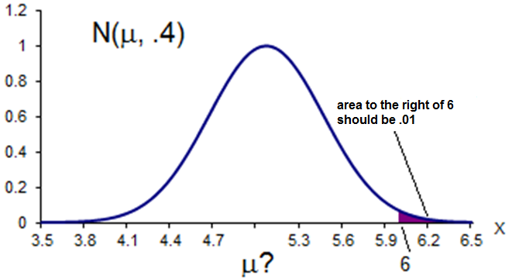
Solution

Slide 33
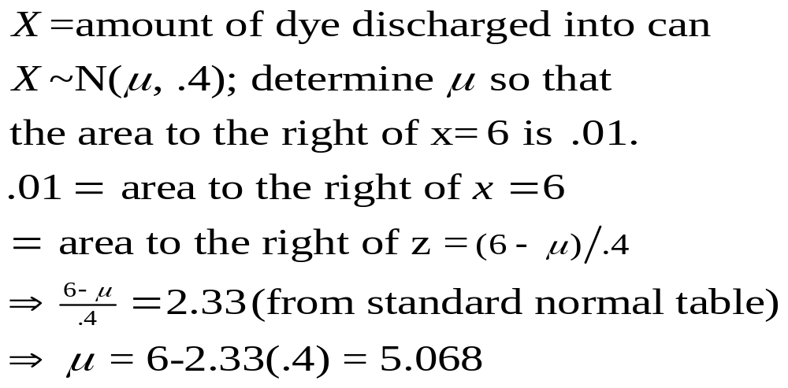
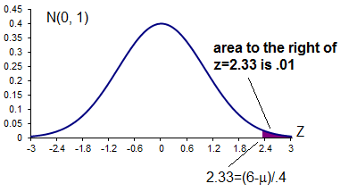
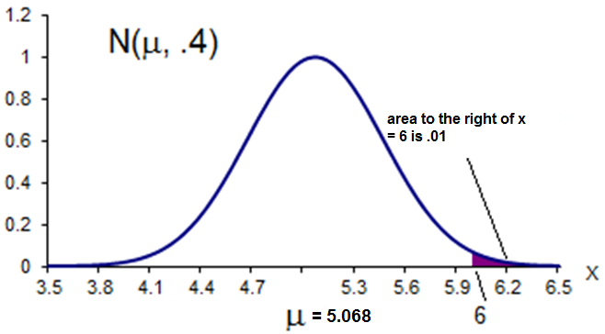
Solution (cont.)

Slide 34


Are You Normal? Normal Probability Plots
Checking your data to determine if a normal model is appropriate

Slide 35
Are You Normal? Normal Probability Plots
When you actually have your own data, you must check to see whether a Normal model is reasonable.
Looking at a histogram of the data is a good way to check that the underlying distribution is roughly unimodal and symmetric.

Slide 36
Are You Normal? Normal Probability Plots (cont)
A more specialized graphical display that can help you decide whether a Normal model is appropriate is the Normal probability plot.
If the distribution of the data is roughly Normal, the Normal probability plot approximates a diagonal straight line. Deviations from a straight line indicate that the distribution is not Normal.

Slide 37
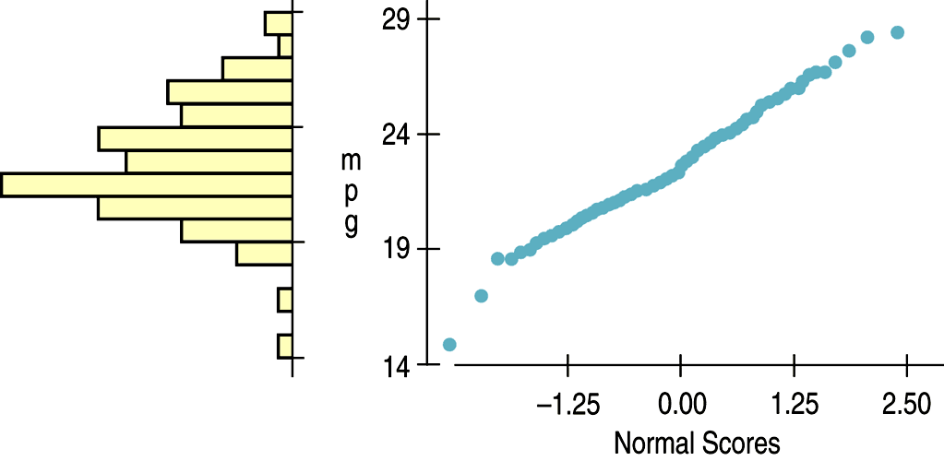
Are You Normal? Normal Probability Plots (cont)
Nearly Normal data have a histogram and a Normal probability plot that look somewhat like this example:

Slide 38
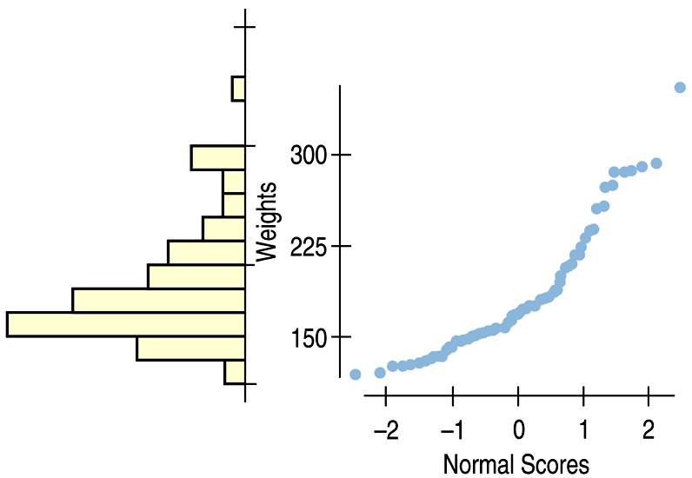
Are You Normal? Normal Probability Plots (cont)
A skewed distribution might have a histogram and Normal probability plot like this:

